Slide 1

Computational Intelligence
2023/24

Slide 2
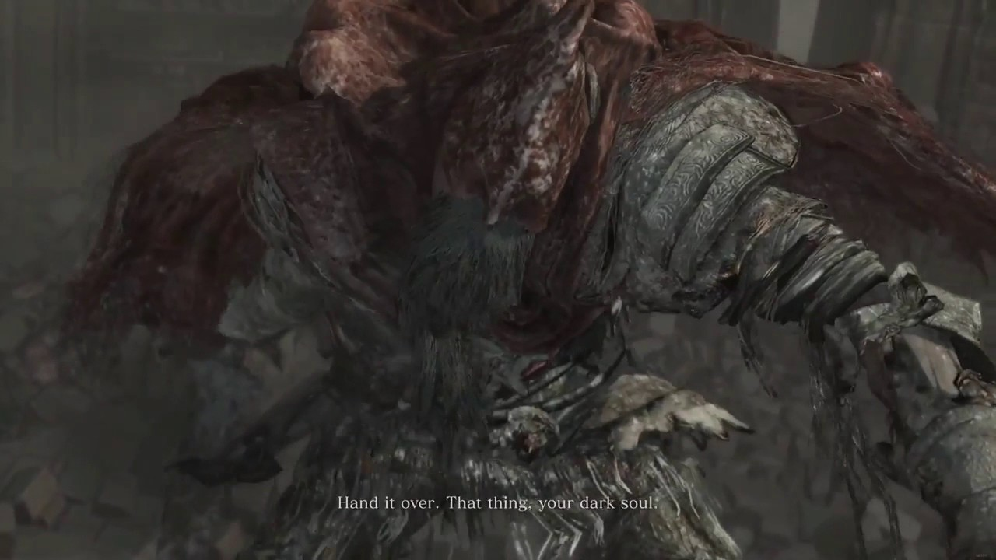
Github repository

Slide 3
Submit your repos!
https://docs.google.com/spreadsheets/d/1ojzatmkNDZnjrYL-6u2wXQqvJaBA9dhzJ2KQFca6oVE/edit?usp=sharing
Write your names and your github repo
Git or html links are both fine

Slide 4
First…
https://github.com/squillero/computational-intelligence.git
Pull request = “I follow the course”
The more you follow the course…
… the shorter the oral exam (you are so many! Wow!)

Slide 5
Set covering
Minimize the number of sets
You saw
Depth first
Breadth first
Best first (greedy)
Now it’s time for A star to rise

Slide 6
Set covering
A*
Heuristic H drives the algorithm
Admissible
Monotonic
Build a new H
Consider the old H (distance)
What about “special sets”?
What about the order of the sets?

Slide 7
Deadline
Thursday, 26/10/2023 h23:59 AOE
(dd/mm/yyyy)

Slide 8


